Slide 1

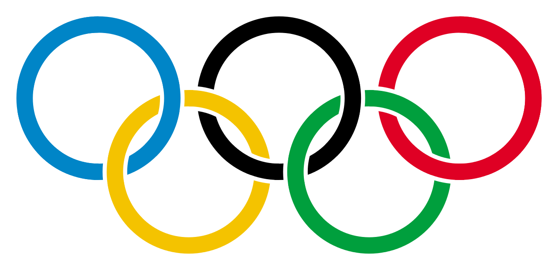
Choosing a Champion
Sagar Chadha
Jinming Li
Cory Nguyen
Matt Zlotnik

Slide 2
The Hurdle
The Olympics are coming up soon, and you want an Olympian to represent your brand
You don’t want just any Olympian…you want a winner to champion your cause!
So how do you find yourself a winner?
An athlete is likely to medal if they represent one of the top countries, with a near-optimal BMI, and playing in their country’s best sports.

Slide 3
Description of the Data
Our data contains all participating athletes from every summer Olympic Games
Athletes’ ages, heights (cm), weights (kg), country, event, sport, and result (what medal, if any, that they won) are reported
We can find countries with the most winners and discover which physical traits are common among these winners

Slide 4
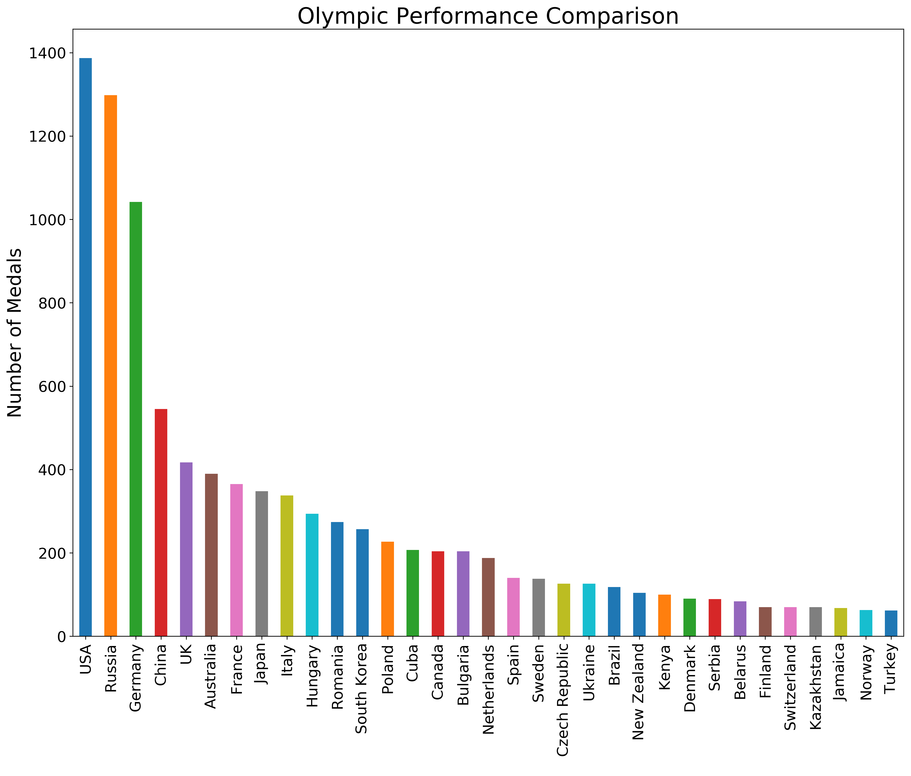
Where is our Contender?
Who has won medals historically?
Notes:
These are the countries that have over 60 medals in total. Why 60? So that the x-axis would be readable.

Slide 5
Do Host Countries have an Advantage?
Notes:
#### Insights:
Listed all the hosting country and plotted each trend to see if they reach a local maximum when they are hosting Olympics:
1. Most of teams performed better than they did in the previous year when their countries hosted the Olympics events.
2. The number of medals for most of teams reached a local maximum when they hosted the Olympics.
3. After countries hosted Olympics, their performances next year tended to be better than they were in the year before they hosted Olympics.
4. Among the four most competitive countries, US doesn't have home advantage because the first peak should not count since Russia refused to attend 1984 Olympics. Germany doesn't have home advantage since their athletes won more medals next year. Russia is unknown for home advantage since US did not attend the 1980 Olympics when Russia hosted the event. China has home advantage when they hosted the event on 2008.

Slide 6
What about the Athletes at Home?
Notes:
#### Insights:
1. The percentage of medal won by each athlete for each country when hosted the Olympics event did not reach a local maximum for most of the teams.
2. The number of medal per athlete for each country can be interpreted as the efficiency of winning a medal for each athletes.
3. It is interesting to see that when a country is hosting the Olympics, the efficency of winning a medal for each athletes actually comes down.
4. The reason behind this is that when a country is hosting the Olympics, the popularity increases a lot within that country. The number of athletes participating in the Olympics outweighs the number of medals they win. For example, more people participate in the event since they all want to make contribution to the country, but the medals they win are propotionally less than the number of athletes. Therefore, on average, the percentage of medal won by each athlete for each country actually goes down when a country is hosting the Olympics.

Slide 7
Let’s Revisit this Graph…
Home field isn’t helpful to our cause, so let’s look at the countries with the most medals.
Notes:
These are the countries that have over 60 medals in total. Why 60? So that the x-axis would be readable.

Slide 8
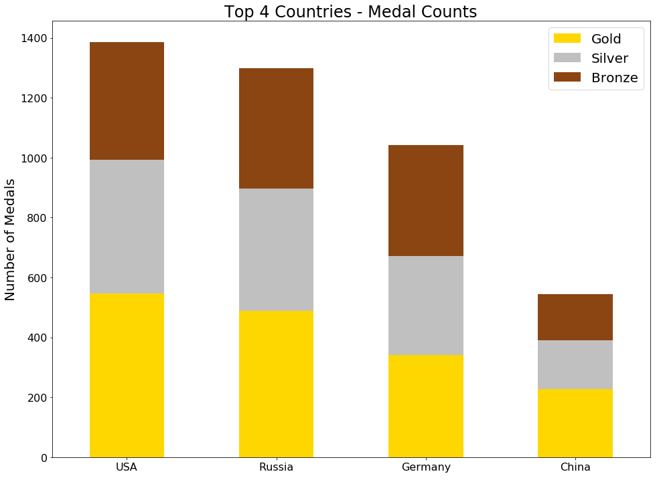
The Best of the Best
The Top 4: USA, Russia, Germany, and China

Slide 9
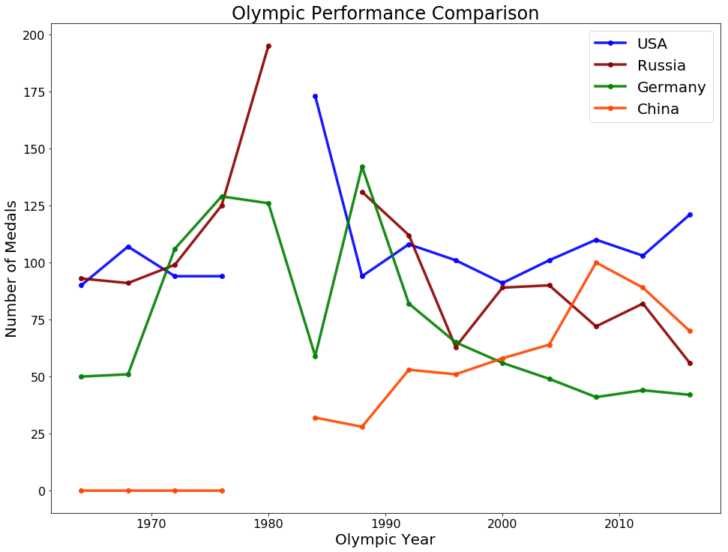
The Top 4 through the Years
We can view Olympic performance by year:

Slide 10
What’s their Secret?
Large contingents are correlated with more medals, with a correlation coefficient of 0.703625
The next slide shows how each top country’s contingent compares to its medal count throughout the years

Slide 11
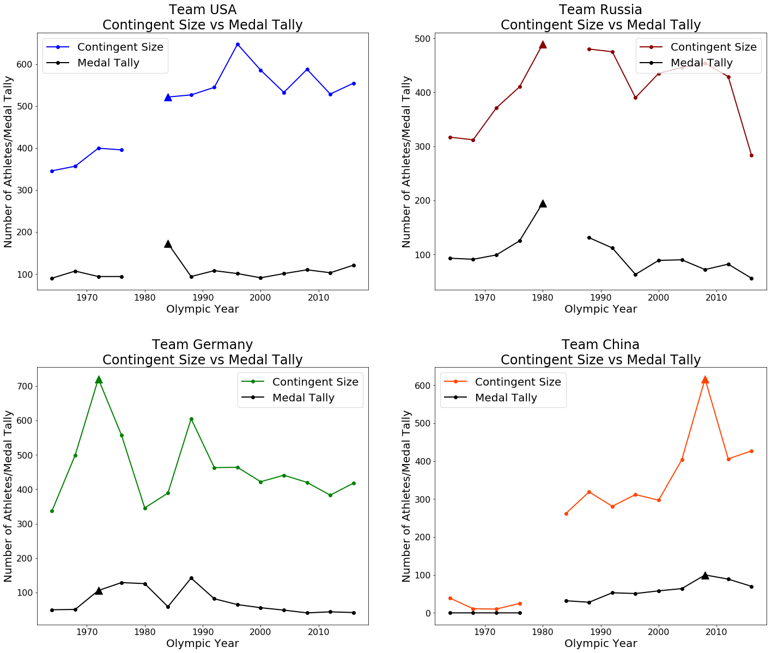

Slide 12
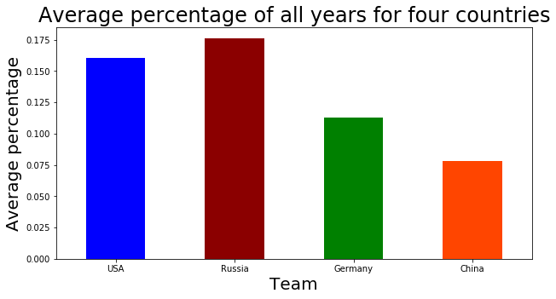
How Efficient are the Top Countries?
Notes:
Correct me if this is wrong: For the US, there are 4 events in athletics (T&F) that contribute the most to their total medal count
Sagar’s note: athletes from these countries in these sports have a better chance of winning

Slide 13
Who Excels Where?
What are the top 5 sports that contribute to each country’s total medal count?
Sport | USA | Russia | Germany | China
Athletics | 4 | 2 | 1 | 0
Gymnastics | 0 | 2 | 0 | 0
Swimming | 1 | 0 | 1 | 0
Table Tennis | 0 | 0 | 0 | 2
Weightlifting | 0 | 0 | 1 | 1
Badminton | 0 | 0 | 0 | 1
Diving | 0 | 0 | 0 | 1
Equestrianism | 0 | 0 | 1 | 0
Modern Pentathlon | 0 | 1 | 0 | 0
Rowing | 0 | 0 | 1 | 0
Notes:
Correct me if this is wrong: For the US, there are 4 events in athletics (T&F) that contribute the most to their total medal count
Sagar’s note: athletes from these countries in these sports have a better chance of winning

Slide 14
A Closer Look at the Athletes
Notes:
It is worth noting that now men and women have equal representation

Slide 15
Let’s look at their BMIs
We already know that men and women naturally have varying BMI, so we will analyze BMI by country stratified by gender
Scaled BMI: Regular BMI:
Medal | Female | Male
Gold | 0.222 | 0.170
Silver | 0.202 | 0.170
Bronze | 0.200 | 0.151
No Medal | -0.037 | -0.026
Medal | Female | Male
Gold | 21.590 | 23.910
Silver | 21.552 | 23.924
Bronze | 21.625 | 23.886
No Medal | 21.026 | 23.400
Notes:
This proves that BMI does have something to do with winning medals. Left uses scaled BMI’s, Right uses regular BMI’s.

Slide 16
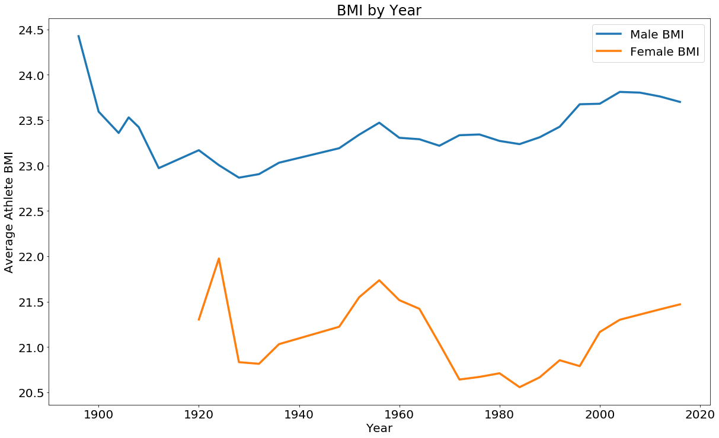
BMI Analysis
How has BMI changed throughout the years?

Slide 17
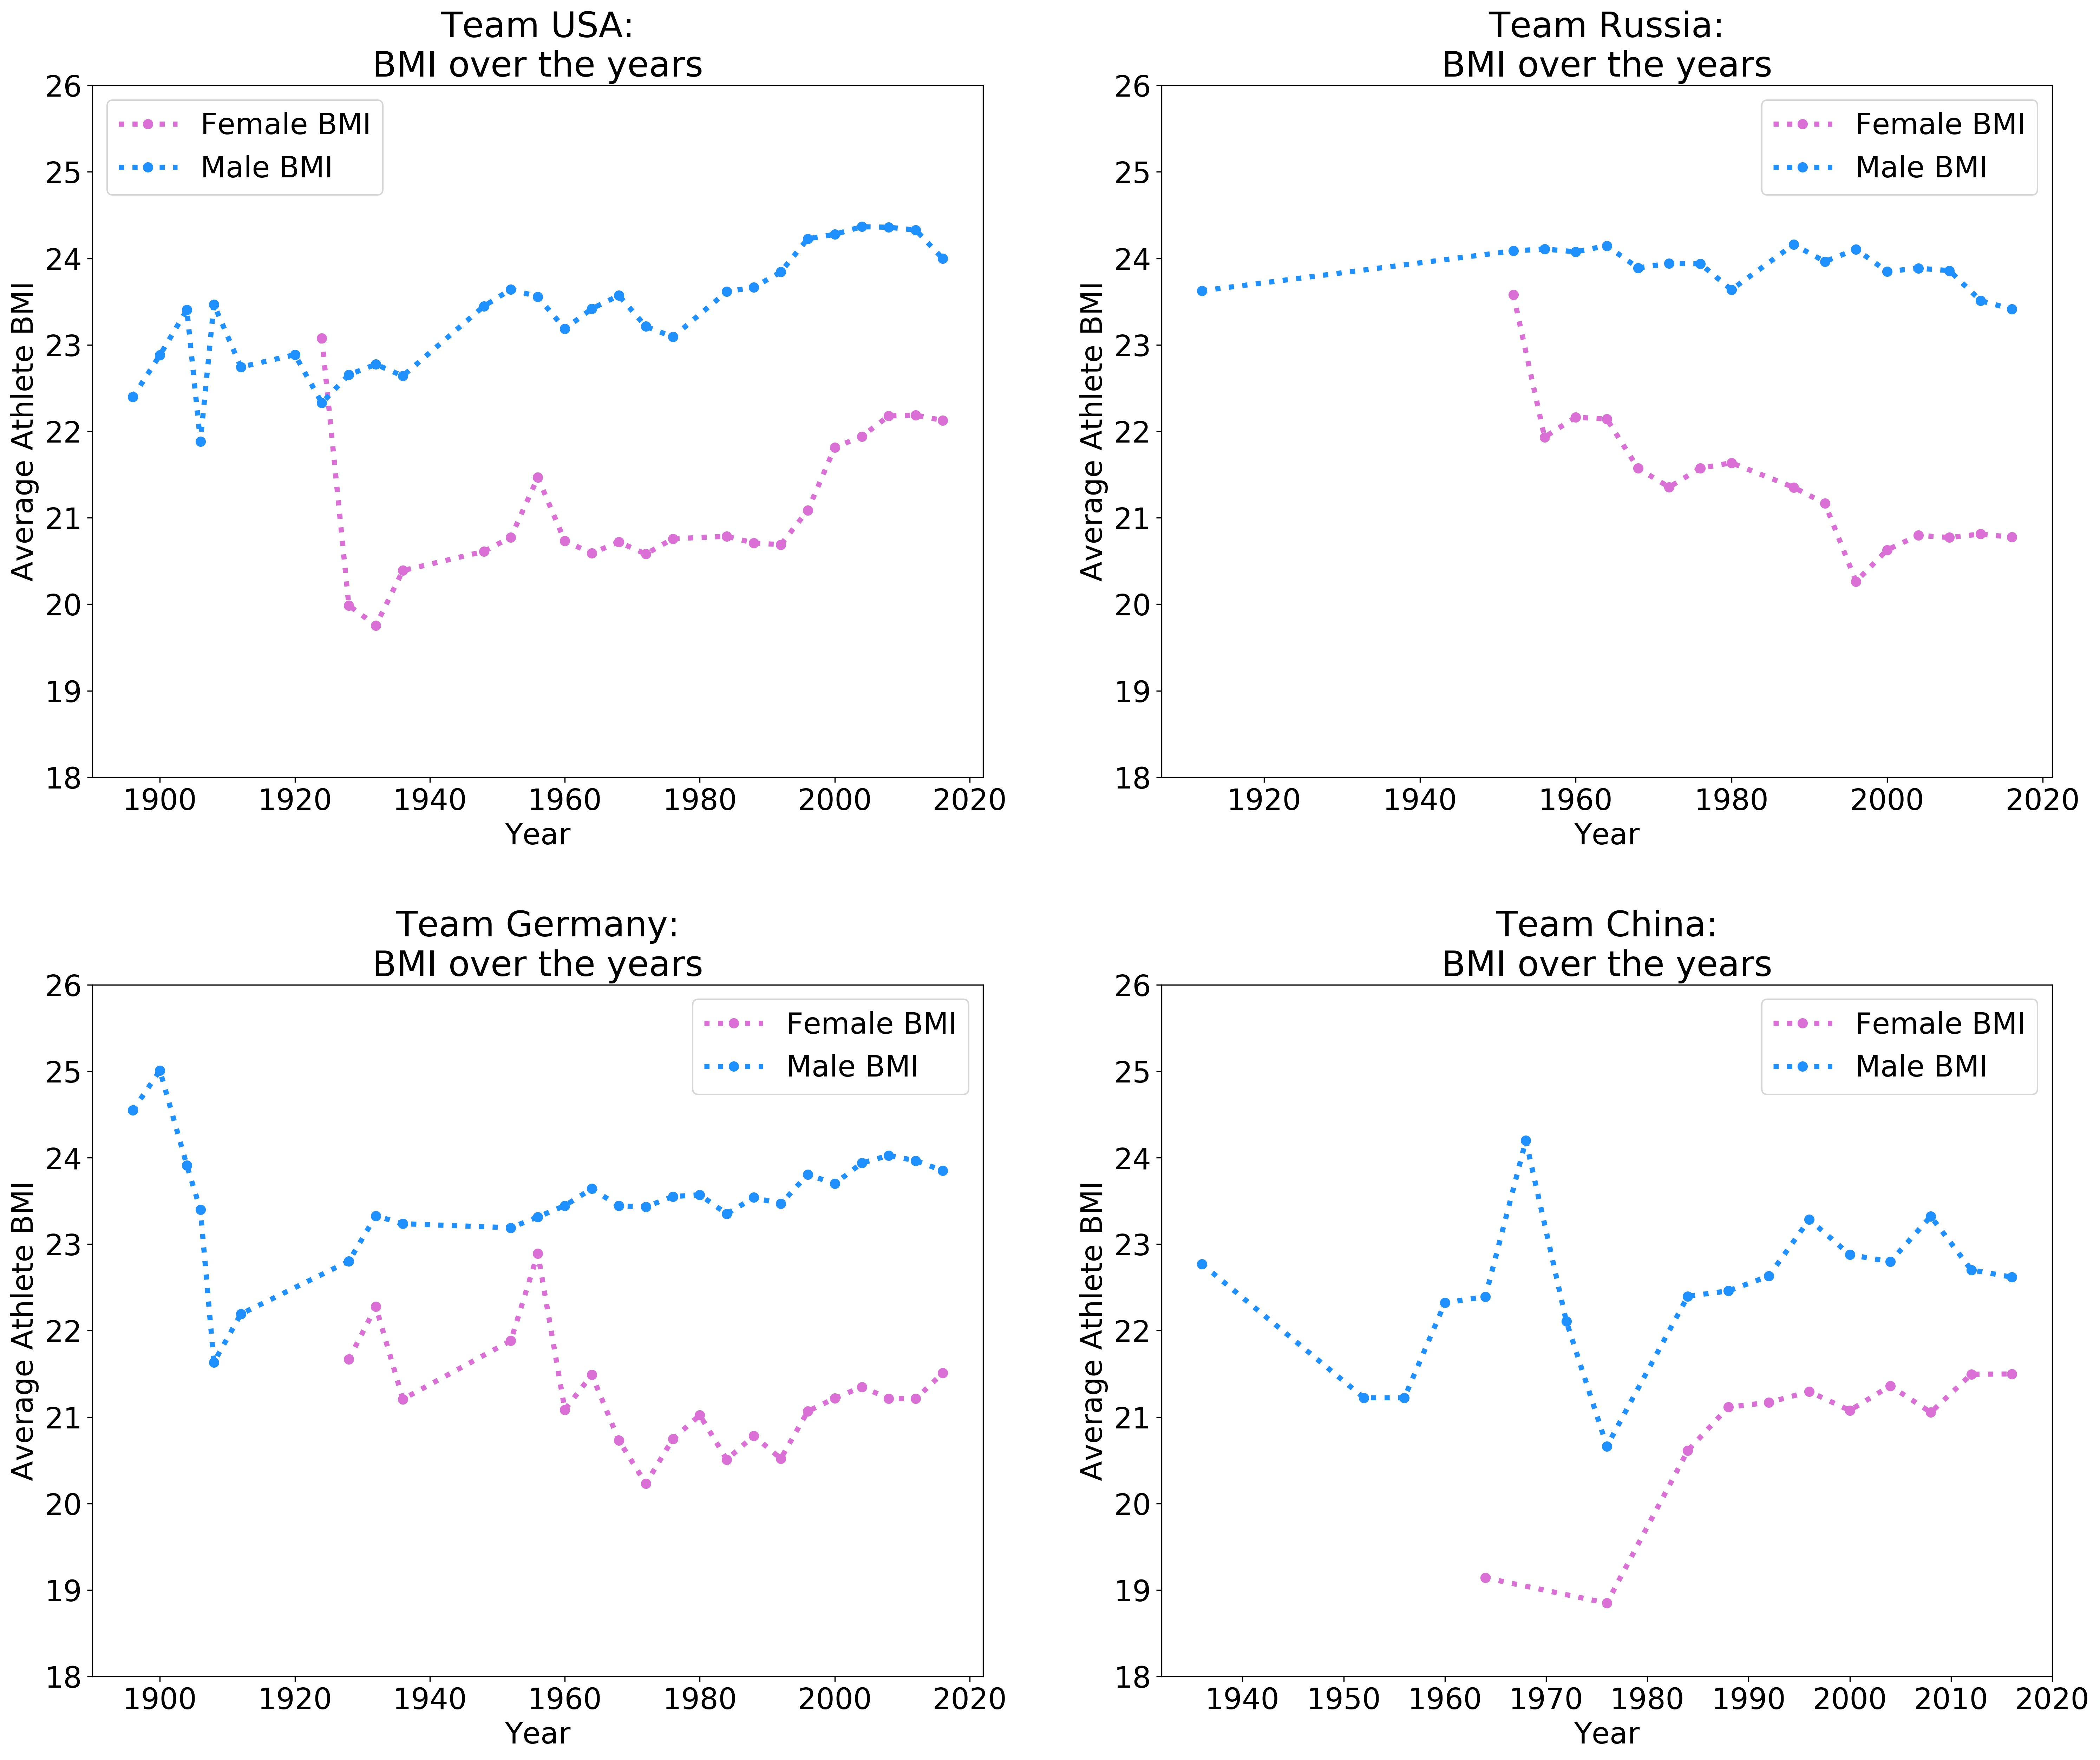
BMI Analysis

Slide 18
BMI Analysis of Country’s Best Sports
Top Events - USA | Average BMI
Athletics Men's 4 x 400 metres Relay | 22.481
Athletics Men's 400 metres | 22.307
Basketball Men's Basketball | 24.297
Swimming Men's 4 x 100 metres Medley Relay | 23.539
Swimming Men's 4 x 200 metres Freestyle Relay | 23.233
Top Events - Russia | Average BMI
Fencing Men's Sabre, Team | 23.701
Gymnastics Women's Team All-Around | 18.970
Rhythmic Gymnastics Women's Individual | 16.057
Wrestling Men's Heavyweight, Freestyle | 29.336
Wrestling Men's Light-Heavyweight, Freestyle | 27.170
Top Events - Germany | Average BMI
Athletics Men's Discus Throw | 29.065
Canoeing Women's Kayak Doubles, 500 metres | 22.849
Equestrianism Mixed Dressage, Team | 21.258
Rowing Men's Quadruple Sculls | 25.037
Rowing Women's Quadruple Sculls | 22.686
Top Events - China | Average BMI
Badminton Women's Doubles | 21.647
Diving Women's Platform | 20.396
Diving Women's Springboard | 19.959
Table Tennis Women's Singles | 21.366
Weightlifting Men's Lightweight | 25.028

Slide 19
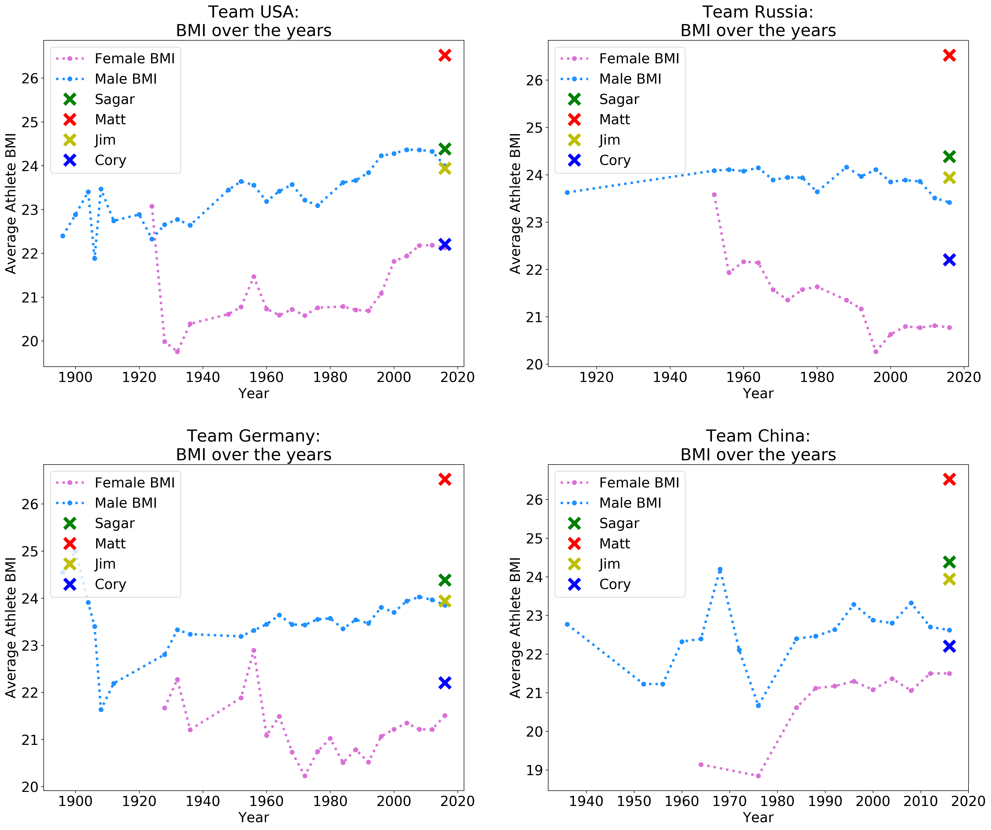
Choosing your Champion

Slide 20
Further Analysis
We also found that GDP and Population are both positively correlated with medal tallies
Winners are more common in wealthier nations
Another good reason to sponsor champions
Suggested future analyses
Examine the performance of other countries
Who is winning the events that the Top 4 aren’t?
Are there nations with large upward trends?
Expand athlete analysis beyond BMI
Age, Years of competition, Past medals, etc.

Slide 21
Conclusion
When choosing an athlete to sponsor:
Home advantage favors countries, but not athletes
Top 4 countries: USA, Russia, Germany, and China
These countries do not share many of their best events
Countries send an even amount of men and women
These athletes have a consistent BMI range
So, when we look at athletes, we need to consider their country, sport, and BMI

